Slide 2
The Creaking Grounds

Slide 3
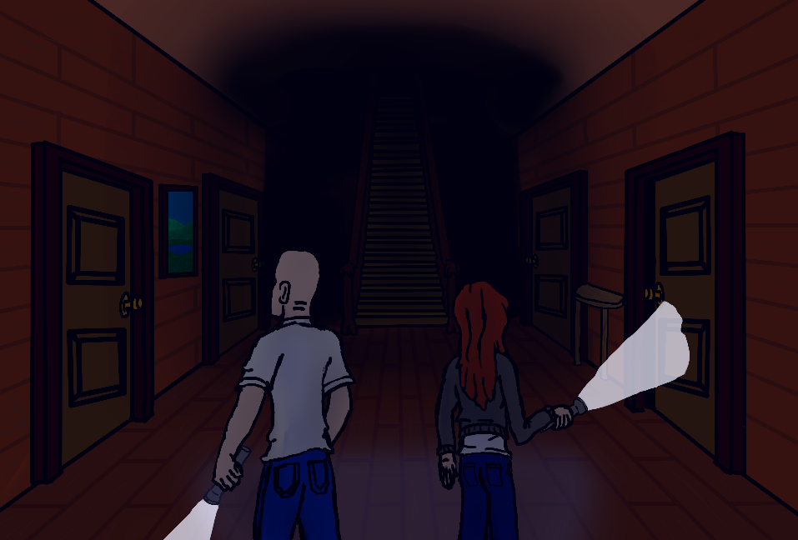
Razor Statement
Explore the old mansion collecting items to survive. But beware the cursed spirits of this house who lie in wait with surprises of their own.

Slide 4
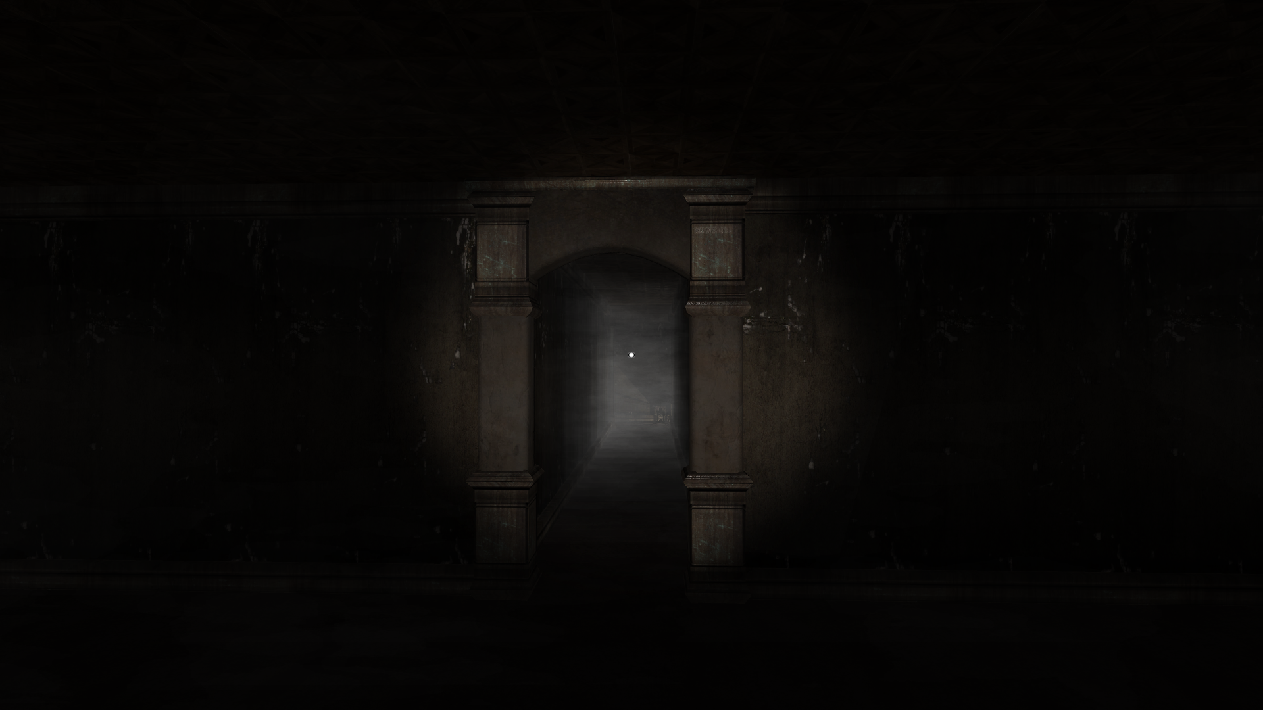
User Story
You and your friends decide to venture into the haunted mansion in your town. You all thought it was just folktales, but little did you know, not all of you will make it home tonight. You will adventure around the mansion with your team to find equipment and uncover artifacts. Complete objectives with your teammates to reach the end. But be careful, for something may just set off the Curse’s Awakening and nothing has prepared you for that moment.

Slide 5
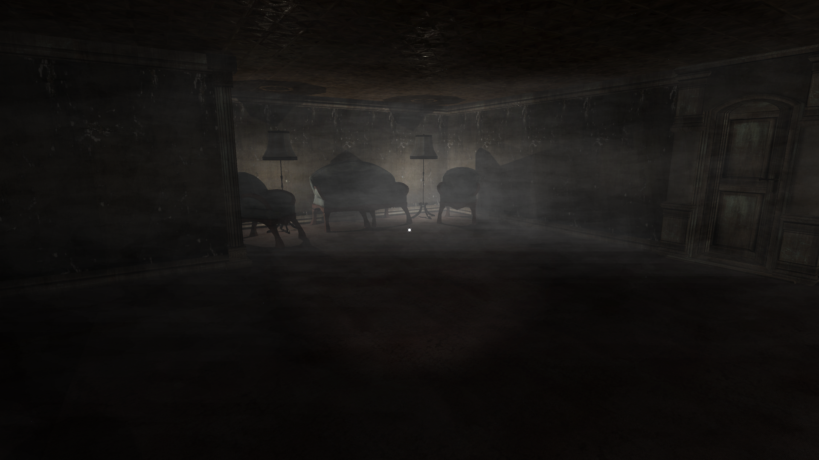
Game Features
Explore a randomly generated labyrinthine mansion
Create a character with stats to suit your play style
Search the rooms and containers for items and artifacts
Find hidden passages and secrets to help you win
Collect special powers from artifacts
Survive the Curse’s Awakening OR Destroy the trespassers as Betrayer.

Slide 6
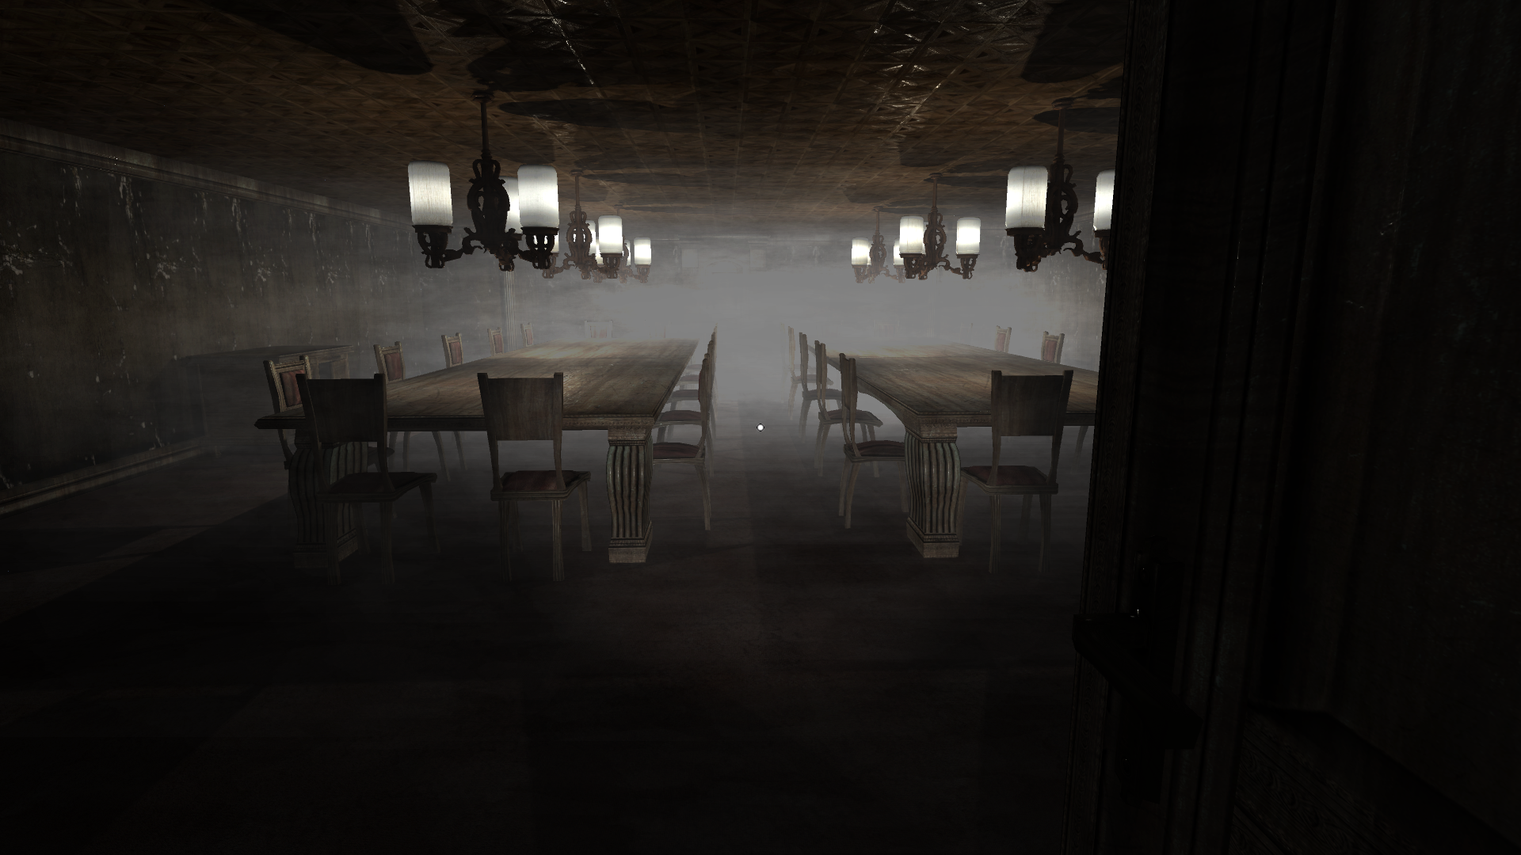
Competition and Why We Are Different
Competitors: Other multiplayer horror experiences
Dead Realm: Similar round structure, but simplistic and underdeveloped.
Damned: Singular goal of escape or kill, no variance.
Faceless: Multiplayer, multi-objective. No randomness, AI controlled monster.
Most horror games are linear and repetitive. Ours is not.
Multiplayer
We are an ambitious group that focuses on quality
Much accomplished in short time already = PROFIT SOONER FOR YOU

Slide 7
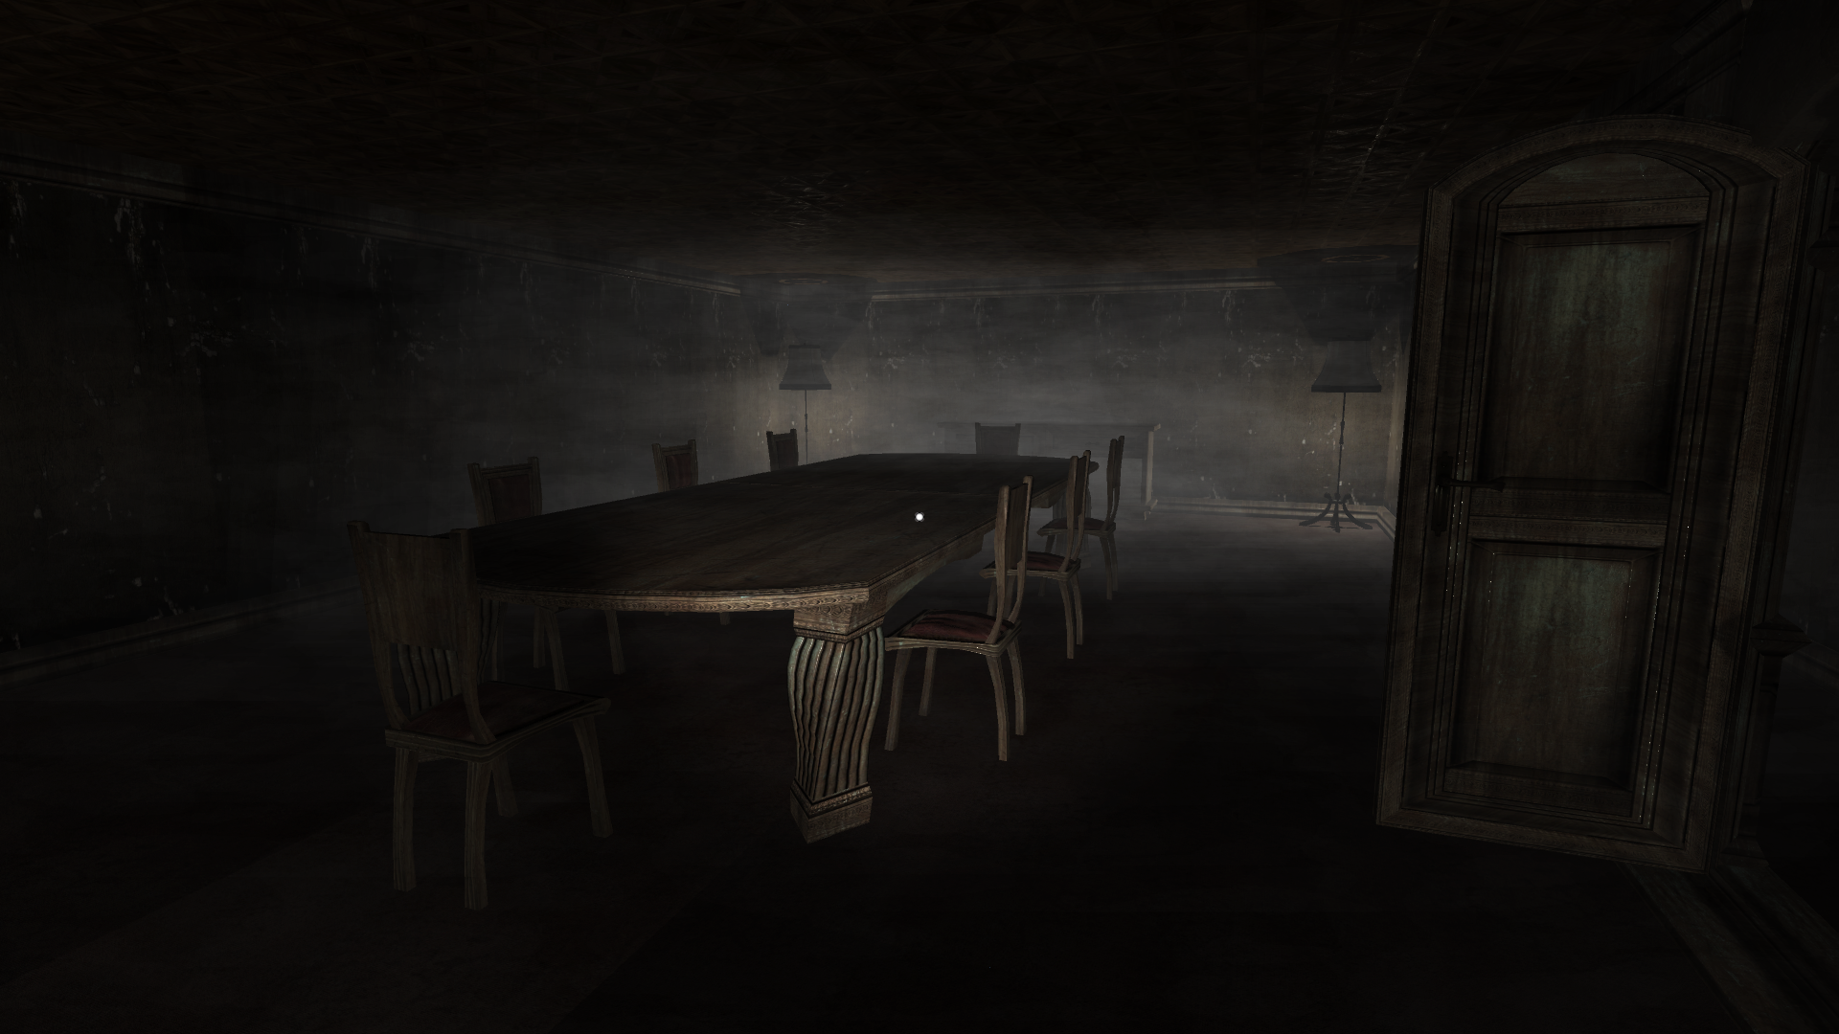
Team Members and Contributions:
Andrew Eagle:
Lead Design
Developed mansion environment
Developed the soundtrack
Conner Garrison:
Lead Programmer
Animation code
Main game-cycle coding
Character Creation
Sean Drevs:
Lead Artist
Made art assets for items and perks
Developed 3D Models for players
Jason Marquez:
Executive Producer
Networking code
Task-management & Organization

Slide 8
The Budget
$200,000
Salaries
Rent
Software Licenses
Additional skill-set team members

Slide 9
The Creaking Grounds

